Slide 1


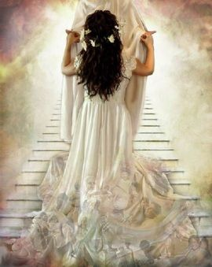
Calendar of
The Calendar of All Calendars!
All bride PPTs should be deleted and keep only this one from 9-20-19 as there are changes on slide 2 for sure. The consensus was to launch and if re-done to add some fishing questions in for the waiting days. – especially from Neil.
Introduction:
Blueprint for
the Bride
Notes:
Oct 25th 1030-1130 am

Slide 2
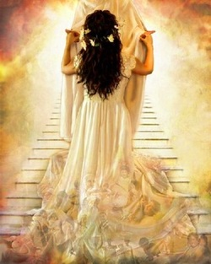
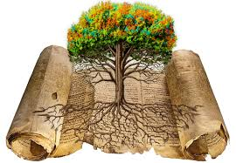
Yahuah’s Covenant Calendar
All bride PPTs should be deleted and keep only this one. 9-19-19
There are many calendars in this world, and many more religious calendars – all claiming to be the “right calendar” to propose how Yahuah’s Calendar can be accurately found.
This study will be based
on the Covenant Calendar
rooted in the Torah Books
of Gen & Exo where the
Book of the Covenant
is found, named
and blood ratified.
Introduction:
The Bride’s Blueprint
Notes:
Oct 25 – 320 pm
Oct 25th – 3 pm … OK Yahuah, I’m having a hard time getting started with this power point. Please help me to have some direction and make the best use of my time and your time as well. I’m ready for You to just show me what to do, and how to put this together for the people at Kelowna. You know who is going to be there, and You know what they need to hear and how. So, let me be led completely by You right now, I ask in Yahusha’s name. Amen

Slide 3
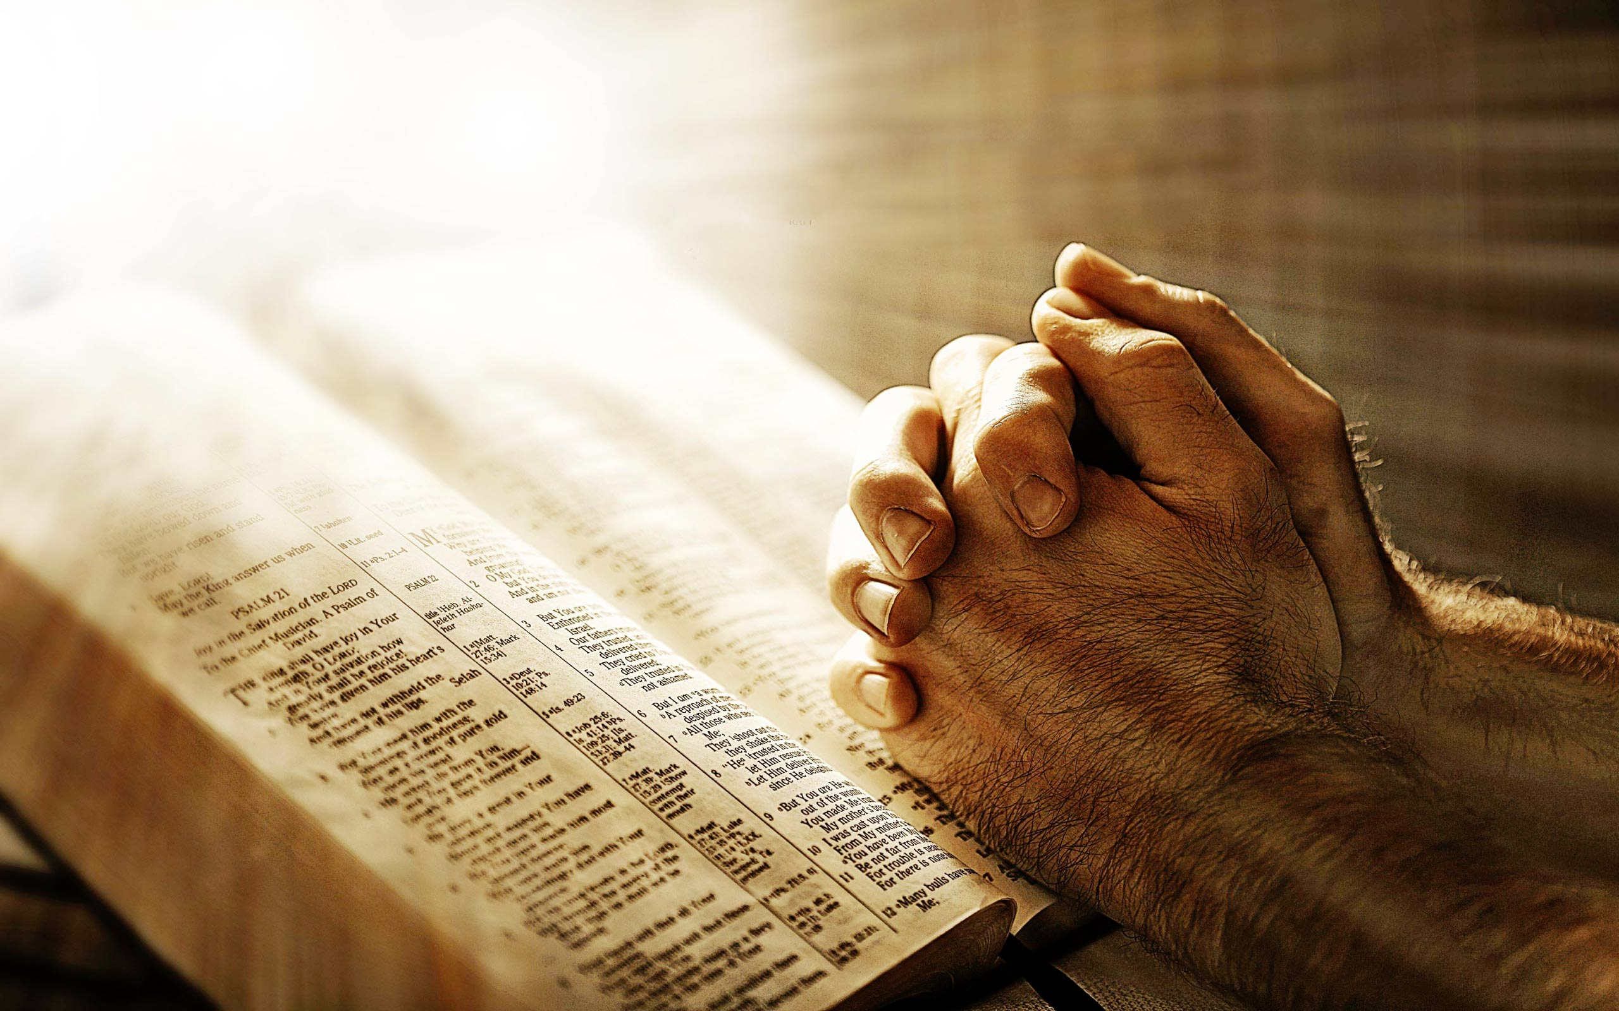
Prayerfully Ponder the
Following Information
Considering Scriptural
Titles & Expressions
Note: The calendar studies prefer to use the Sacred Name above all else.
However, the next few slides use KJV language for a very specific reason. Please enjoy.
Notes:
Oct 25 330 pm

Slide 4

Ps 136:3
O give thanks
to the
Lord of lords:
for his mercy endureth
for ever.
T
I
T
L
E
S
Who is this
Lord of lords?
Notes:
Oct 25th 339 pm

Slide 5

Who is
this
King of kings?
1 Tim 6:15
Which in his times he shall shew, who is the blessed and only Potentate, the King of kings,
and Lord of lords.
Notes:
Oct 25th 353 pm

Slide 6

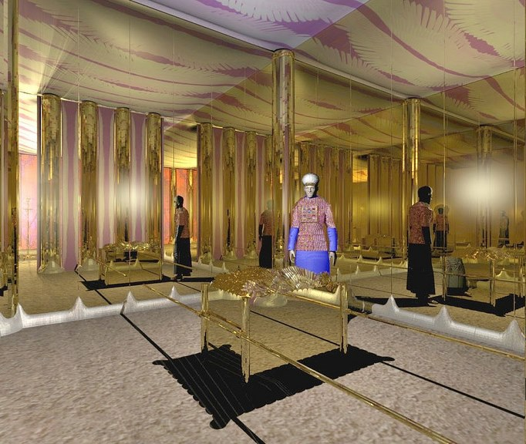
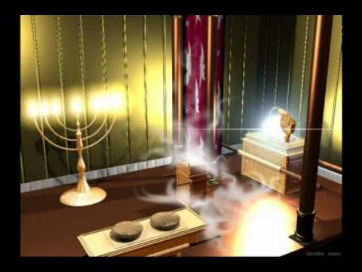
Holy of Holies
Where is this Most Holy of Holies?
2 Chron 5:7
And the priests brought in the ark of the covenant … into the most holy place, even under the wings of the cherubims:
Notes:
Oct 27th 1250 pm

Slide 7

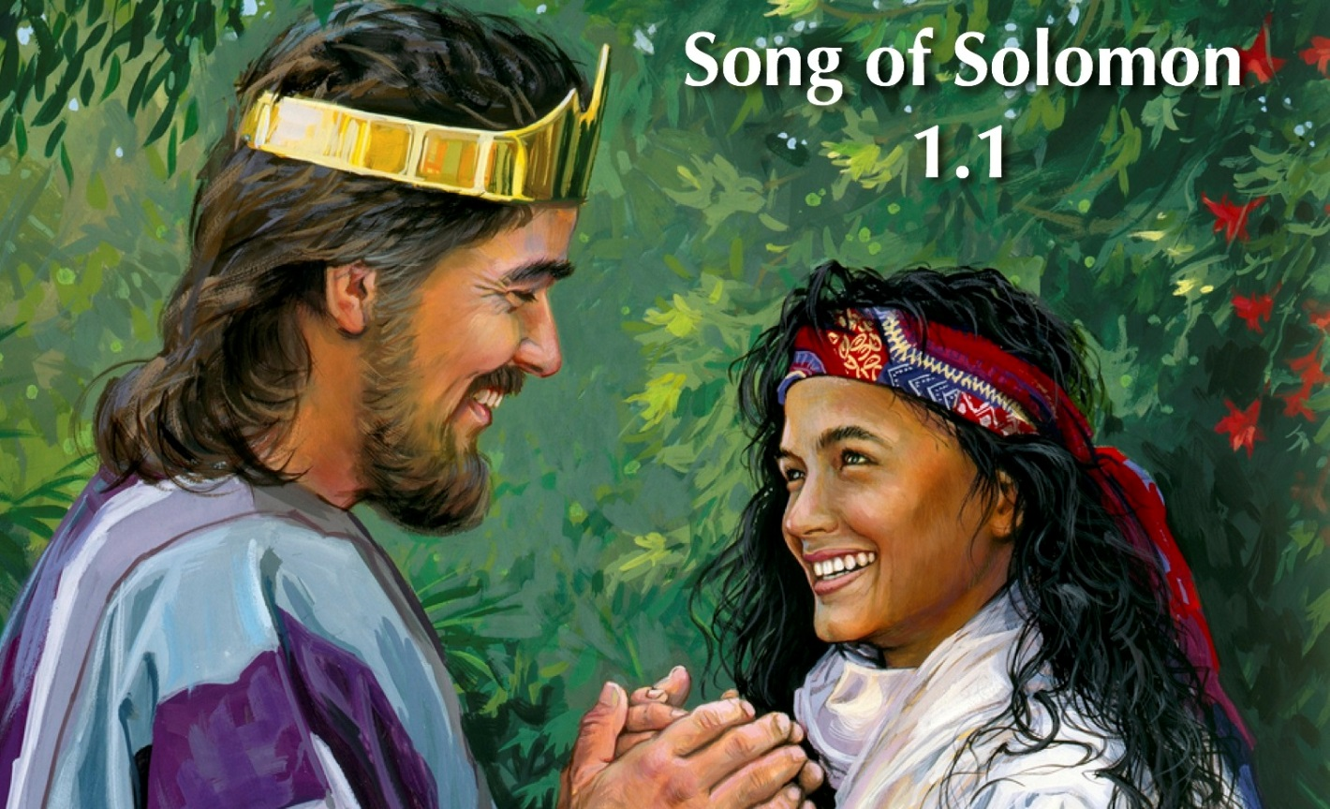
Song of Songs
:
What is this
Song of Songs?
Who is this
Beloved of beloved’s?
Song 1:1 The Song of songs, which is Solomon's.
Song 6:3 I am my beloved's,
and my beloved is mine:
Notes:
Oct 25th 404 pm

Slide 8



Awaiting the King
Who is this Bride
waiting for
her Beloved?
Rev 19:7 Let us be glad and rejoice, and give honour to him: for the marriage of the Lamb is come, and his wife hath made herself ready.
Notes:
Oct 25th 430 pm

Slide 9

Wedding of All Weddings
What is this
Wedding of Weddings?
Matt 22:3 And sent forth his servants
to call them that were bidden to the wedding.
Notes:
Oct 25th 445 pm

Slide 10

Longing for my Beloved
Song of Songs 5:13
His cheeks are like beds of spice to me.
I will put on my best clothes and gather a bouquet of heavenly thoughts of my Beloved because I find all loveliness and joy in Him.
I see His cheeks so often bedewed with tears of sympathy;
then so cruelly beaten with a rod and defiled with my spittle.
Ah! That cheek smiles at me with the most fragrant mercy
towards my heart.
My Beloved, You did not hide Your face from shame and spitting.
I will always find my dearest delight in praising You!
Yes, Your cheeks were crimsoned with blood from your
thorn-crowned temples.
It is these marks of boundless love that attract my soul
far more than beds of scented herbs.
Notes:
Nov 16th new slides to finish ppt. 1000-1115 am

Slide 11


Oh, if I may not see the
whole of my Beloved’s face,
then I would be content to
behold His cheeks.
For the slightest glimpse of Him
is exceedingly refreshing and
yields to my spirit a variety
of delights!
In my Beloved, I find not only
fragrance, but beds of spice.
Not from one flower but all kinds of sweet flowers.
He is my rose and my lily, my violet and my cluster of henna.
Notes:
Added Nov 16th finished at noon

Slide 12

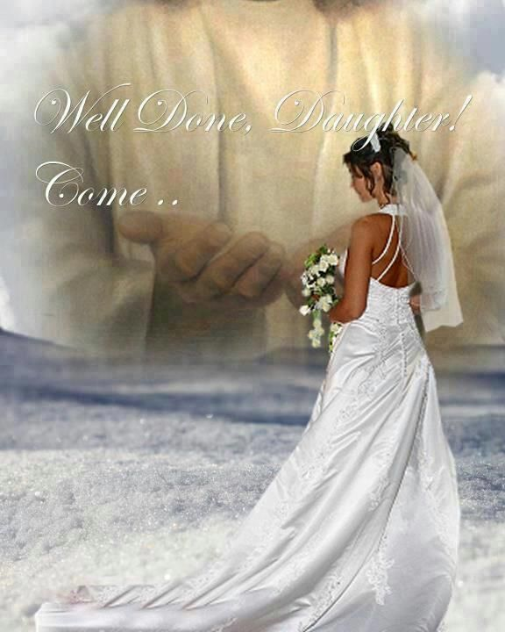
When You are with me, my soul goes forth
to wash its happy face in the morning dew
of Your grace.
If I may not see the whole of Your face,
allow me to behold Your cheeks!
Oh my precious Beloved,
I long for You!
Let me truly know the blessedness
that dwells in abiding through
unbroken fellowship with You
until that Wedding Day of all
weddings in the universe!
(Thoughts taken from May 1 reading of
Day by Day with the Best of Spurgeon
by Dolores Coupland, 2010)
Yes!
I Will Come!
Notes:
Added nov 16th – finished at noon

Slide 13



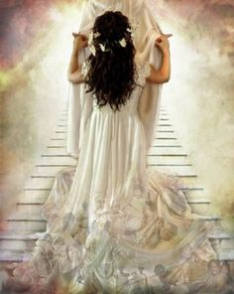
How Does She Save the DATE for this Wedding of Weddings?
The Bride needs to understand how to calculate the …
… on her Beloved’s
Covenant Calendar.
Notes:
Oct 25th 505 pm

Slide 14
That’s Why This Study
Will Be Called:
The Calendar
of
All Calendars!
Notes:
Oct 25th 800 pm

Slide 15



Taking a Very Brief Look
At
Calendar of
Notes:
Oct 25th 517 pm

Slide 16


As a Little Child – Hear & Obey
Hear the Torah
Listen to the Torah
Follow the Torah of
Matt 18:4
Whosoever therefore shall humble himself as this little child, the same is greatest in the kingdom of heaven.
Notes:
Oct 25th 900 pm
Tim 3:15 And that from a child thou hast known the holy scriptures, which are able to make thee wise unto salvation through faith which is in Christ Jesus.

Slide 17

Some Incredible Confusion
There are so many different [Scriptural] calendars out there, how can anyone know which one is right?
Some begin their calendar with the
moon date closest to the equinox or equilux.
Other calendars begin with the first
moon date after the equinox or equilux.
Some say the moon phase must
be the sighting of the first sliver.
Others contend the moon phase must be in conjunction – or the “dark moon” phase.
Still others are just sure the moon must be a
full moon to begin the calendar month.
And the list goes on and on with dozens of ways!
1st Assessment: All these calendars cannot be right! (Equinox and equilux are certainly different!)
2nd Assessment: All of these calendars could be completely wrong!
Is there a solution to this dilemma?
Notes:
Oct 26th 135 pm

Slide 18

Components of the
Covenant Calendar as Given by Moses
Every calendar has their individual characteristics:
Day-start
Month-start
Year-start
Worship Days
Appointed Times or Special Holidays
4. Worship Days
3. Year-start
5. Appointed Times
2. Month-start
1. Day-start
Rooted in
Covenant
Notes:
Oct 25th – 545-600-630 pm

Slide 19



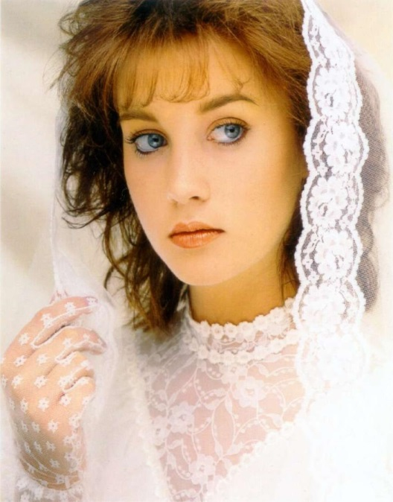
Focus of This
Calendar Study
2. Month-start
(Difficult)
… is a Calendar study important?
1. Day-start
(Easy)
3. Year-start
(Moderate)
Rooted in
Covenant
So the Bride knows the
date of her wedding!
Notes:
Oct 26th 1145 am – 1215 pm

Slide 20
Some Important Questions
There are so many different [Scriptural] calendars out there, how are we supposed to know which one is right?
For day-start: some calendars follow sunset, midnight, sunrise and dawn twilight. How can we be sure what to follow?
For month-start: There are so many variations using the moon, how can one know which variation is right?
For Year-start: Between all the different combinations, can the year begin either before or after the equinox?
Or equilux? Surely every combination can’t be right?
For weekly Sabbath-start: There are many varieties now! Who can sort out this problem? (Lunar Sabbaths?)
All of these calendar issues are affected in many
different ways, which also tampers with the proper commencement times for the Appointed Times of worship. Is there really a solution?
Yes, Moses has the answer in his Torah books.
All the answers are firmly given in Yahuah’s Covenant.
Notes:
Oct 25th 730-750 pm

Slide 21
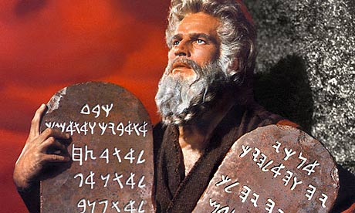
Where is Yahuah’s
Book of the Covenant Found?
Between Gen 1:1 and Exodus 24:11!
Yahuah’s Covenant Calendar is well grounded in Genesis and Exodus.
Day <yowm> is given
on the first day of
creation. Gen 1:1-5.
Month <chodesh> is
found in Gen 7-8.
First 3 months (including
appointed times) found in Exodus 3-20.
Year <shaneh & [spring] tequfah>: Exo 12:2.
Notes:
Oct 25th 750 – 810 pm

Slide 22

Outline for Understanding Yahuah’s Covenant Calendar
Calendar Day Start:
Gen 1: First day of Creation
Lev 23: Day of Atonement (vss 26-32)
Calendar Month Start:
Gen 7-8: Noah and the Flood Account
Exo 12: 1st Mon - Passover From Egypt
Exo 16: 2nd Mon - First Manna Week
Exo 19: 3rd Mon - Pentecost at Mt Sinai
Calendar Year Start:
Exo 12: “tequfah” [Equinox]
Calendar’s Relationship to the Moon:
Old Testament Study: “The Moon, Oh the Moon!”
Moses preserved the
Covenant Calendar
with his writings
in the Torah.
Notes:
Oct 25^{nov} 16/16 new slide for introduction. 650 pm

Slide 23
Understanding Day-start
From the Torah Books
Day-start Witnesses
Between Gen 1:1 & Exo 24:11
(Book of the Covenant)
Day-start Witnesses
From Exo 24:12 – Deut 34:12
(Book of the Law)
Gen 1: 1st day of Creation
Gen 15: Abram’s Covenant
with Yahuah
Gen 19: Lot and his
Daughters
Gen 31: Laban & Jacob
Ex 10: Locust Plague
Ex 12: Passover of Egypt
Ex 14: Red Sea Crossing
Ex 16: Quail & Manna
Ex 19: Pentecost at Mt Sinai
Lev 7: Permission for
Eating
Lev 23: Day of Atonement
Num 9: Passover in the
2nd Month
Day-start Witnesses
from the section of
Book of the Covenant
are much more abundant!
This fact will become
very important!
Notes:
Oct 26th 415 pm

Slide 24
Where are the Day-start Studies Found in Scripture?
Mannie: This might be a hard slide for anyone to understand without me explaining it, so leave out if you want. Or call me and we’ll decide what to do when you are ready. Charlene 250-742-2388
Location of Studies in the Scriptures | # | % of Torah | % of O.T. | Calculation
Covenant Torah Books Gen 1:1-Exo 24:11 | 9 | 75% | -- | 9+3 = 12 9/12 = 75%
Non-Covenant Torah Books Exo 24:12-Deut | 3 | 25% | -- | 9+3 = 12 3/12 = 25%
Total Torah Studies (Gen-Deut) | 12 | 100% | 43% | 12/28 = 43%
Old Testament (Extra Witnesses) (in the Non Torah Books) Joshua-Jonah | 16 | -- | 57% | 12+16 = 28 16/28 = 57%
Total Old Testament | 28 |  | 80% | 28/35 = 80% of Scriptures
Total New Testament | 7 | -- | 20% | 7/35 = 20% of Scriptures
Total Scripture Studies | 35 |  | 100% | 35/35 = 100%
The foundation for the Day-start studies are found in Covenant Torah & Torah.
Many witnesses are found in the Old Testament Non-Torah books.
The New Testament witnesses support Covenant Torah and Non-Torah Books.
Notes:
Oct 26th 415 pm

Slide 25

Time to Make a
Reasonable Assumption!
This chart represents the Genesis 1 Calendar.
Questions: Is the 1st day of creation also:
1st Day | 2nd Day | 3rd Day | 4th Day | 5th Day | Prep Day | Sabbath Day
1 | 2 | 3 | 4 | 5 | 6 | 7
8 | 9 | 10 | 11 | 12 | 13 | 14
15 | 16 | 17 | 18 | 19 | 20 | 21
22 | 23 | 24 | 25 | 26 | 27 | 28
29 | 30
The 1st day of the 1st week?
The 1st day of the 1st month?
The 1st day of the 1st year?
Keep these concepts in mind for each study.
Notes:
Nov 16/16 new slide 650 pm.
Oct 26th 130 pm

Slide 26


Where is the best place to begin to understand the Covenant Calendar study?
That’s a very
good question.
The best place to begin is “at the beginning!”
Let’s take a sneak peek at the
1st day of creation.
26
Notes:
New slide nov 16th 715 pm …

Slide 27

The Calendar Study Begins At:
Genesis 1 & the 1st Day of Creation
The word “evening”
is the Foundation for
Yahuah’s Covenant Calendar
Light
Morning twilight
Evening twilight
Night
OH? …
OK!!
Notes:
Oct 26th 345 pm

Slide 28
Gen 1:5a – 1st Day of Creation
Everything began with “light”
… and the “light” is called Day.
The darkness is called Night.
This “night” is not the “darkness” of Gen 1:2a.
Evening twilight
Day
Night
28
Notes:
Oct 26th 345 pm

Slide 29
Gen 1:5b – introduces “twilights.”
The “light”
is called Day.
The darkness
is called Night.
Morning twilight contains “light.”
Its “light” belongs to the DAY
Season.
Evening twilight contains “light.”
Its “light” belongs to the DAY
Season.
Day Season
Night Season
29
Notes:
Oct 26th 345 pm

Slide 30
Gen 1:5b “twilights” are mixtures
of light and night.
The “light”
is called Day.
The darkness
is called Night.
1) Morning and Evening twilights are
defined as belonging to the DAY Season.
2) Light, or twilight, is never defined
as belonging to the Night Season!
Day Season
Morning twilight
Evening twilight
Night Season
30
Notes:
Oct 26th 345 pm

Slide 31
Gen 1:5b is not a definition for day-start.
It is a definition of “where” these twilights belong.
The “light”
is called Day.
The darkness
is called Night.
And the Evening and the
Morning are [part of] the first day,
(because they belong to DAY Season,
not Night Season)!
Day
Morning twilight
Evening twilight
Night
31
Notes:
Oct 26th 345 pm

Slide 32
Instruction From King David
Ps 90:12 [KJV]
So teach us to
number our days,
that we may apply
our hearts
unto wisdom.
If we know how to count out
Yahuah’s days correctly, then we can
easily count the whole Covenant Calendar.
Notes:
New slide nov 16th 715 pm …

Slide 33
For Calendar: “Learn to Count”
These Days
1-3½ … “midst of the week”
1-7 … to weekly Sabbath
1-30 … to end of one month
1-50 … Firstfruits to Pentecost
1-12 … to number months of the year
1-360 … one full year of 12 months
After 360 … learn to wait for equinox to reset the year.
Notes:
New slide nov 16th 715 pm …

Slide 34
Covenant Calendar in a Nutshell
Blood-Ratified in Melchizedek’s Priesthood
Found in:
Gen 1:1 – Exo 24:11 “Covenant Torah Pages”
DAY: Gen 1:1-5 (Day begins with LIGHT, not sunset, etc.)
MONTH: Gen 7:11 2nd Month & 17th day
Gen 7:24 & 8:3 150 Days (5 mon. of 30 days each.)
Gen 8:4 7th Month & 17th day
YEAR: Exo 12:2 (Year/shaneh) – Spring Equinox/tequfah
Exo 9:31 Barley struck
Exo 34:22 (Fall Equinox/tequfah) [Torah only pages]
(Calendar Year has 360 days; resets with equinox.)
Commands of Moses
Deut 4:19 (vss 15-19) [no gazing at any heavenly bodies]
Deut 17:2-5 (Death penalty by stoning: vss 4-5)
Prov 18:13 He that answereth a matter before
he heareth it, it is folly and shame unto him.
Month count of 1-30 begins the day after the equinox.
Acts 7:22 Moses was trained in all the wisdom of the Egyptians.
Notes:
New slide nov 16th 715 pm …

Slide 35
Questions for the Individual Topics
Prov 25:2 It is the glory of Yahuah to conceal a thing: but the honour of kings is to search out a matter. KJV
For extra information on Covenant Calendar
studies please visit:
www.studythecalendar.com
All questions are important.
Please ask them!
Notes:
New slide nov 16th 715 pm …

Slide 36


Charlene Fortsch BC Canada charlene@studythecalendar.com OR
Tim Astleford AB Canada tim@studythecalendar.com
End of the Short Introduction for
the Covenant Calendar Study
Email your questions to:

